Slide 1

COMP499
Fall 2020/2021
Hadi Abdel Majid
1/7/2021

Slide 2
Table of Contents
Company Overview
Internship Program
Phase1
Phase2
Phase3
Experience Evaluation

Slide 3

Company Overview
Internship Program
Occupation:
Cloud Gate Consulting is company that provides products and services related to Network Automation, auditing and topology mapping in addition to Network security and monitoring assurance.
Type:
Online Unpaid Internship
Location:
Beirut, Lebanon
Damascus International Highway, OPEL Showroom building, First Floor, Hazmieh, Beirut, Lebanon
Duration:
4months
Location:
Business Center Logistic City, Dubai Aviation City,P.O.Box: 390667,Dubai, U.A.E.
Tasks:
Phase1: Prerequisites Self Learning
Phase2: Website User Interface
Phase3: Network Security
Email:
support@cloudgate.consulting

Slide 4
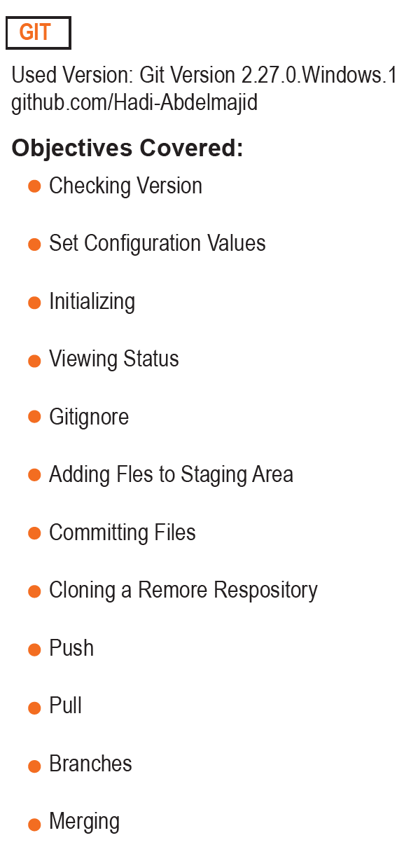

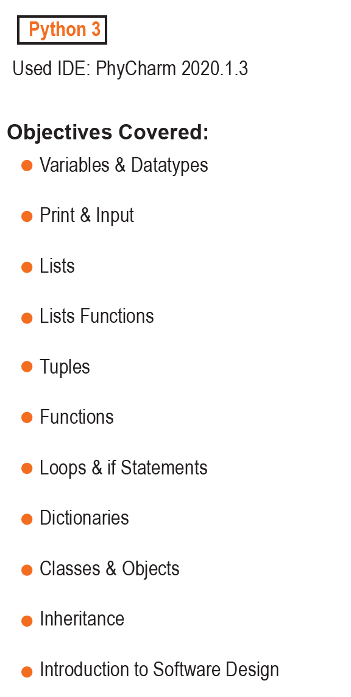

Prerequisites Self Learning

Slide 5



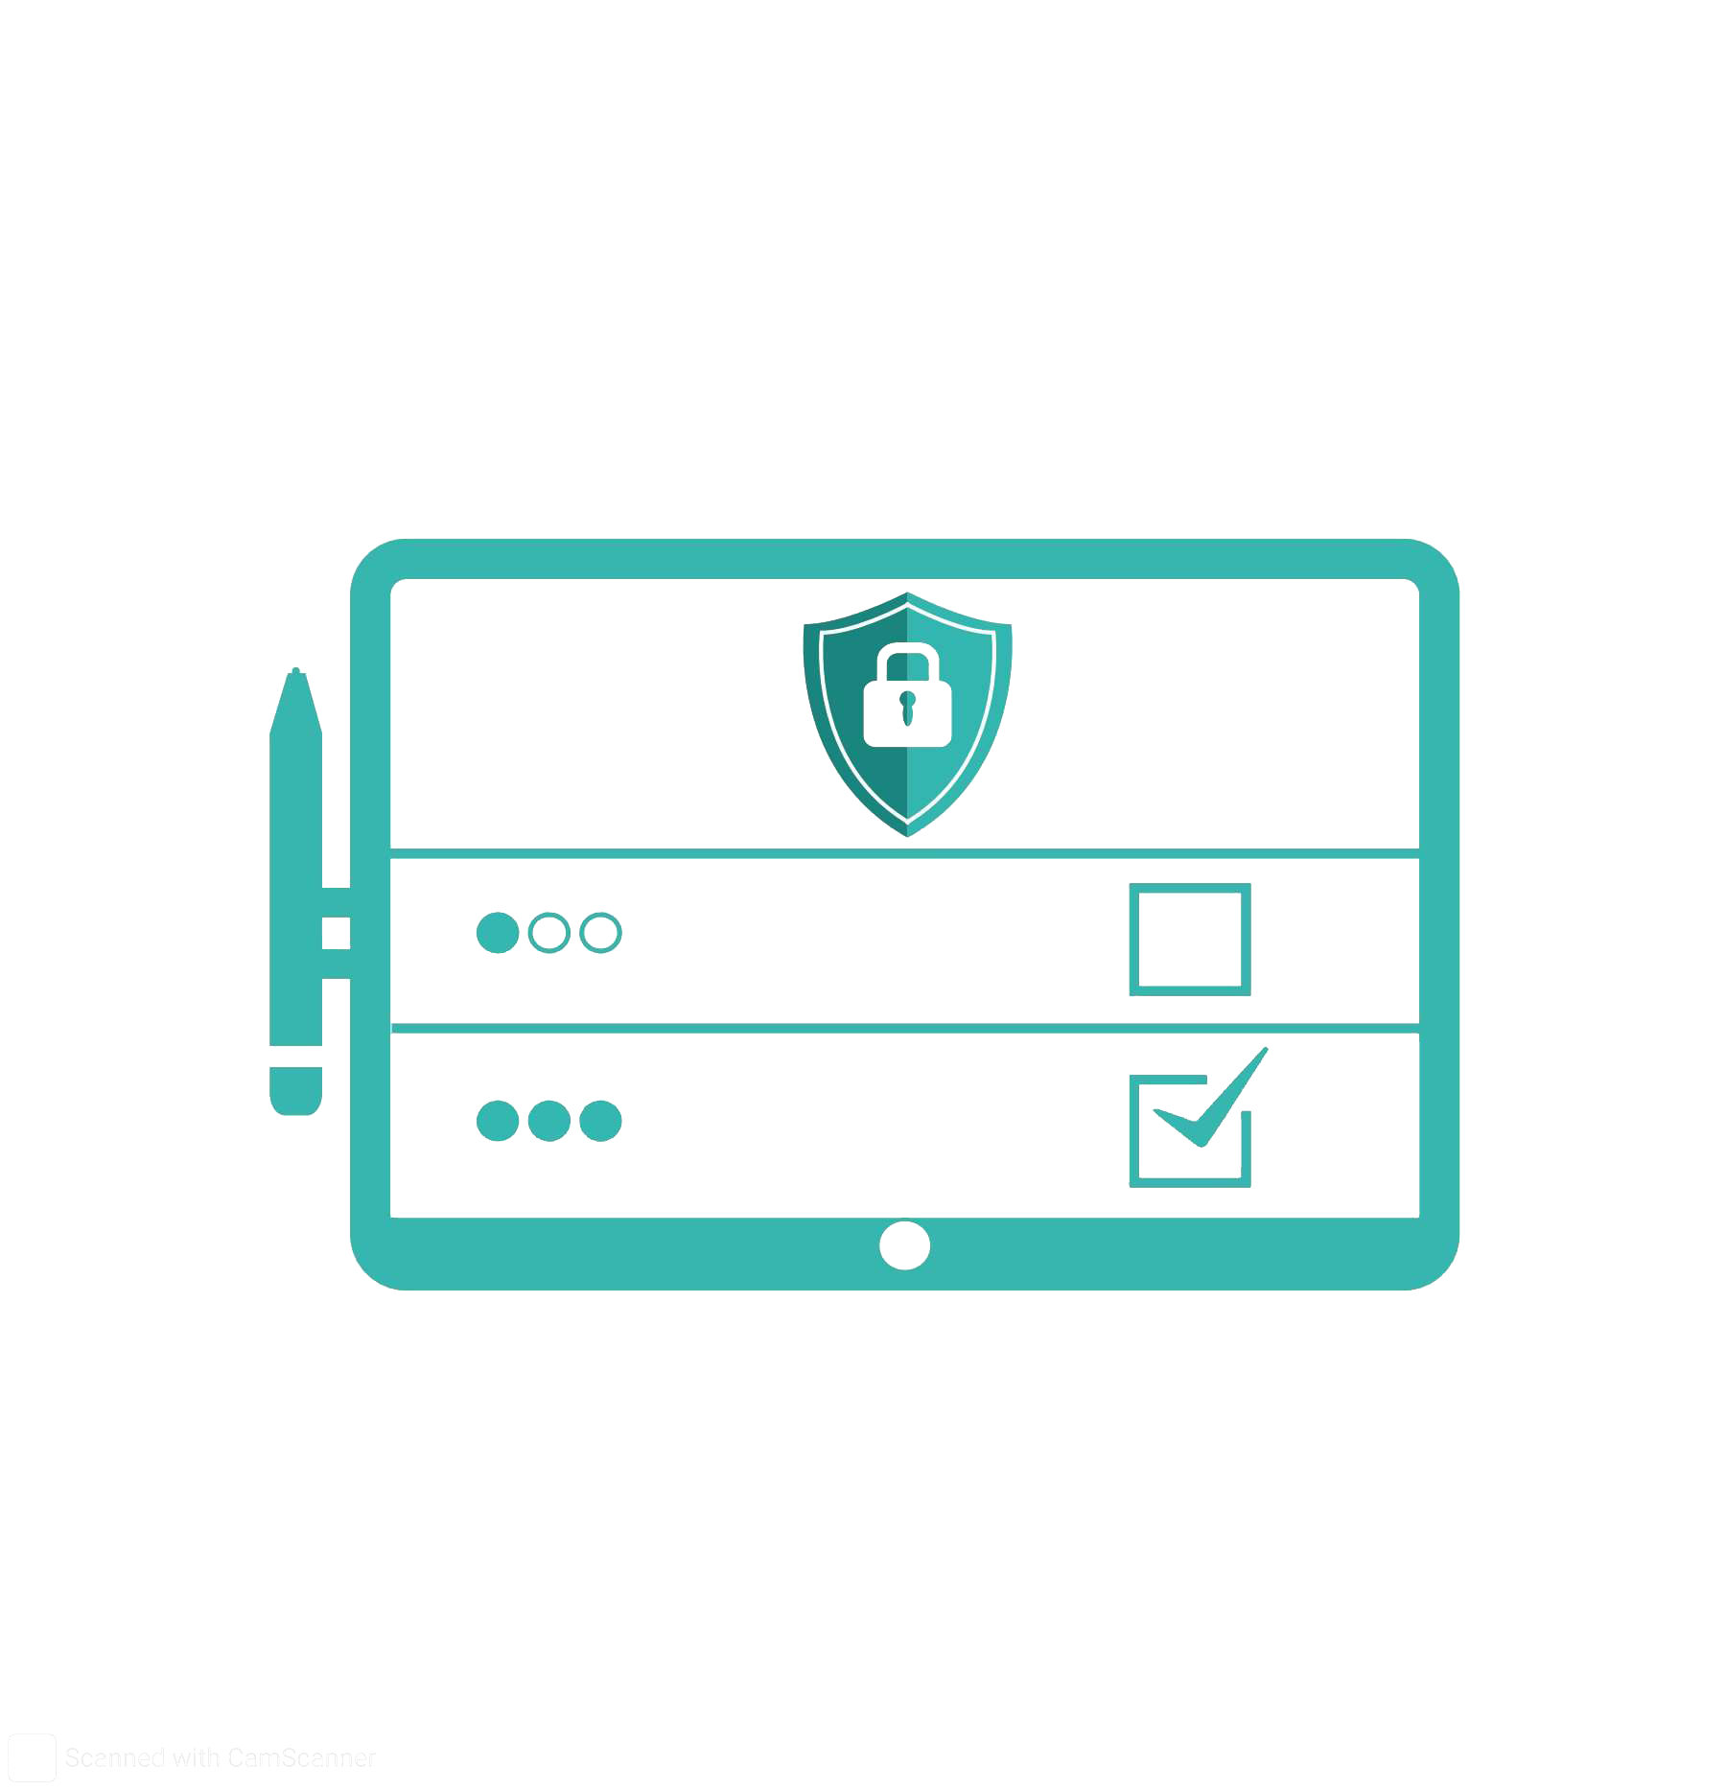


Website User Interface

Slide 6



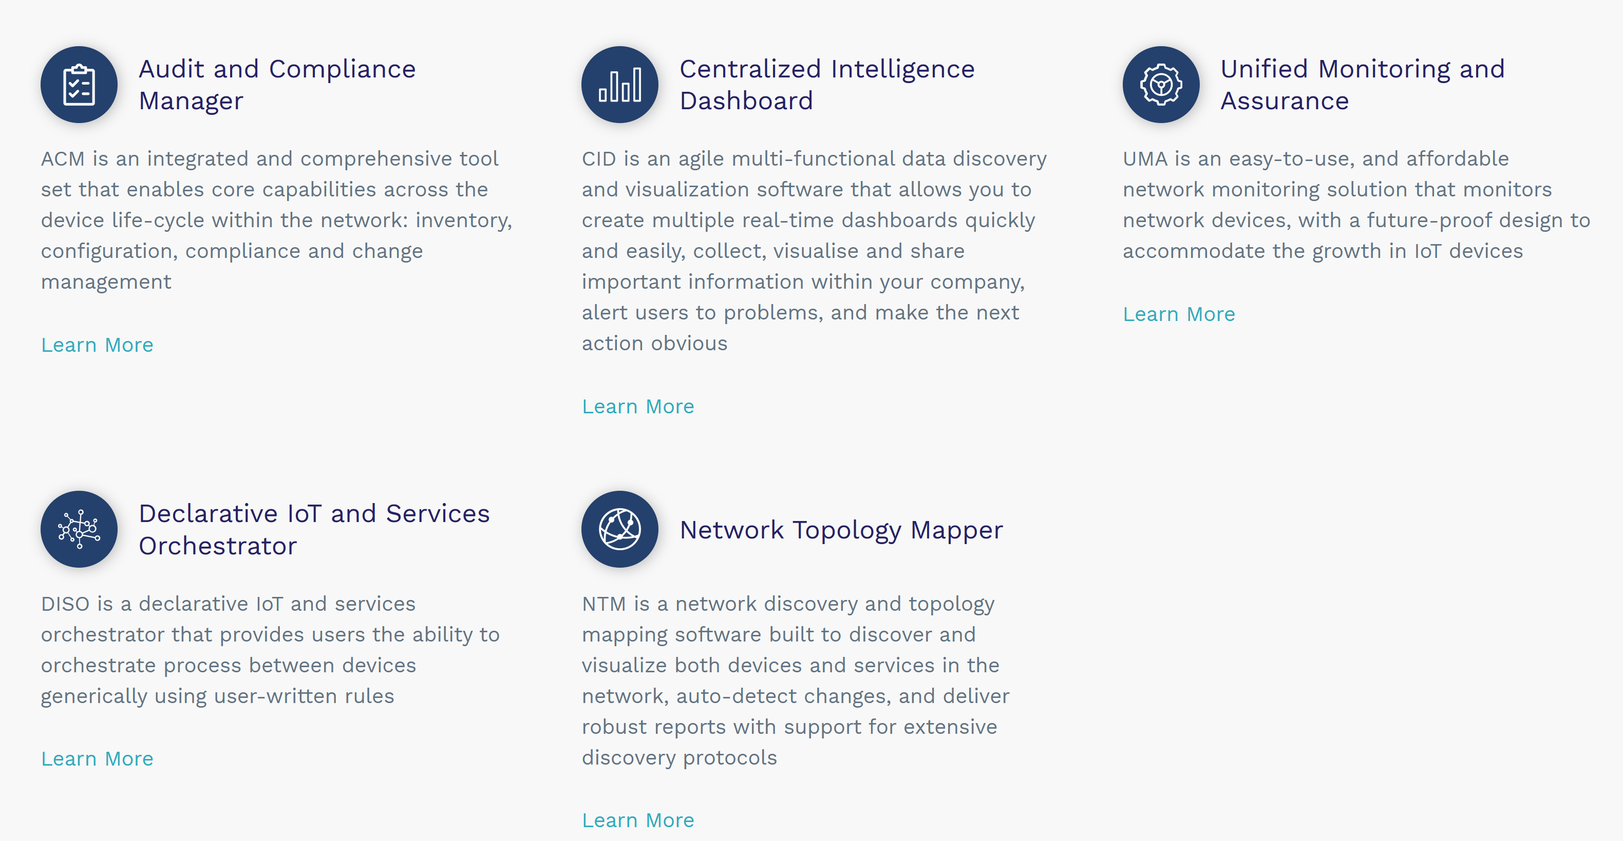
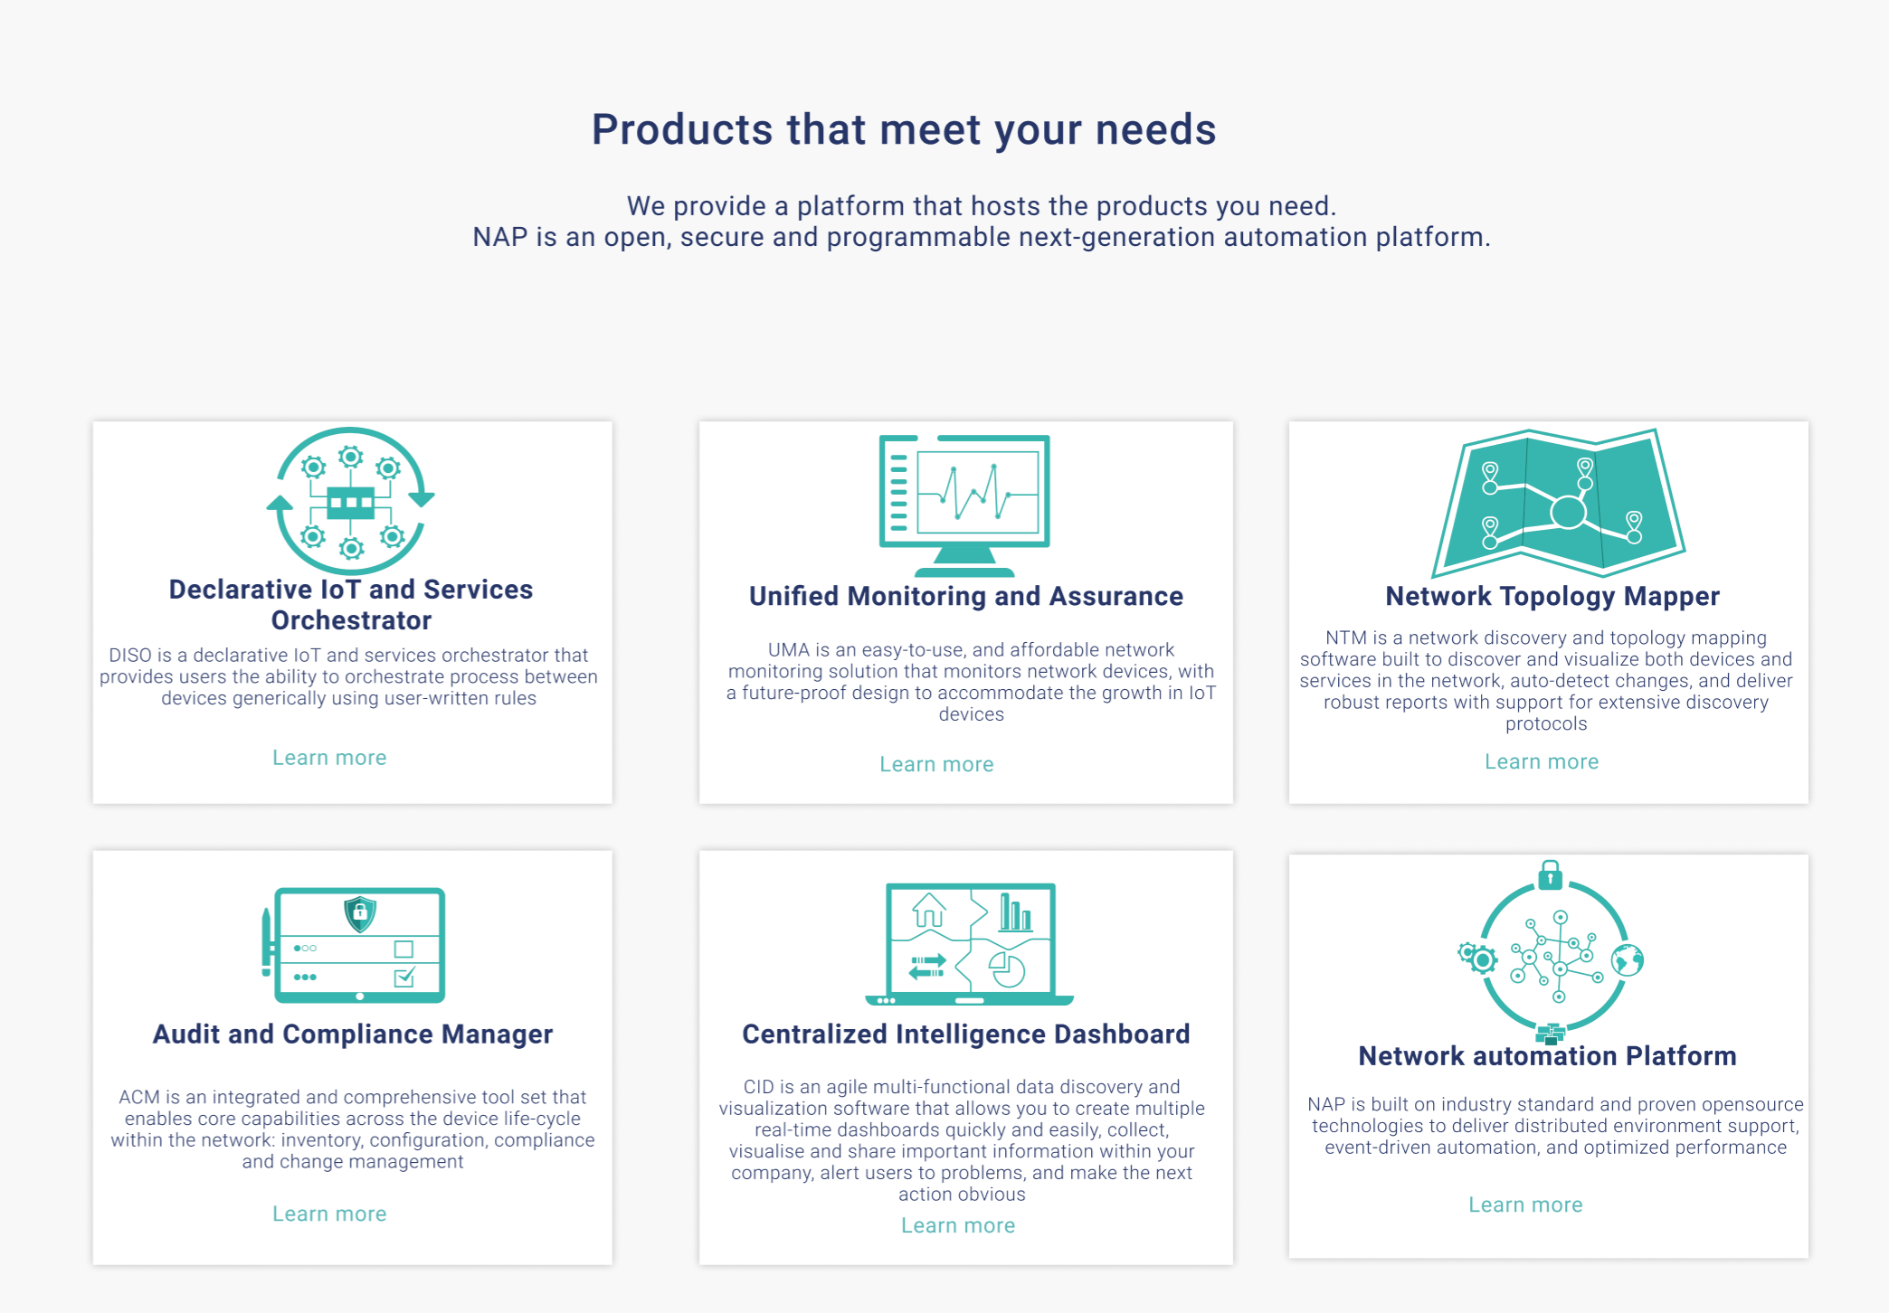
Website User Interface

Slide 7




Network Security
Got Introduced to:
Security Controls
Firewall Filters
CIS Rules
Regular Expressions
Network Compliance Manager:
MBSS
L2VPN
L3VPN
ZTP

Slide 8





Experience Evaluation
Professional Work Flow:
Skills Improved in :
Explored:

